Slide 1

CRUNCH & MUNCH FOODS
SNACKS HAPPY, LIVE TASTY

Slide 2
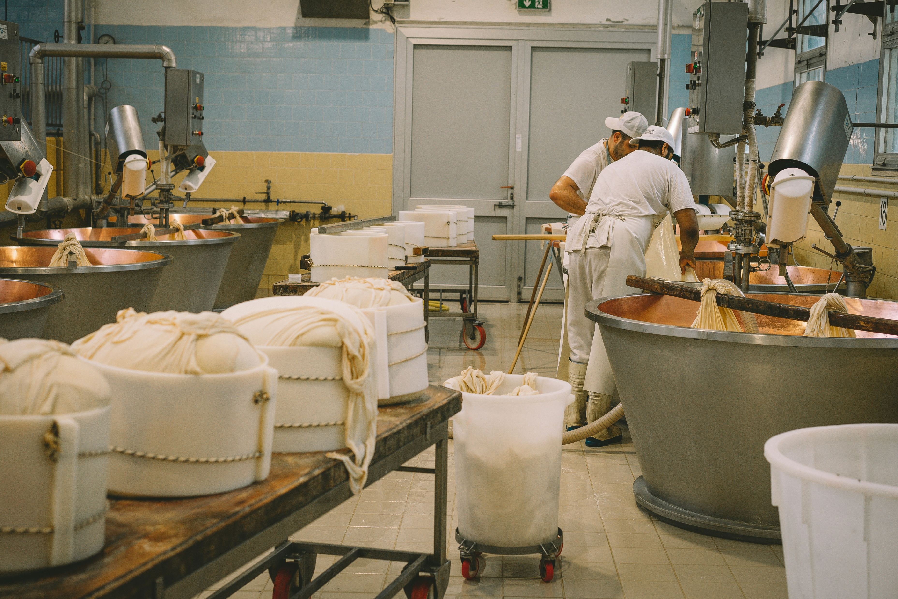
Project Overview Title:
📊 Production Optimization and Forecasting in Food
Manufacturing Content: Domain: Food Manufacturing Tools Used: Python, Jupyter Notebook, Pandas, Seaborn, Matplotlib, Statsmodels
(ARIMA)Duration: 90 Days (Simulated
Data)Objective:> To reduce production waste, analyze downtime trends, and forecast demand to help improve efficiency and reduce costs.

Slide 3
Business Problem & RequirementsBusiness Problem:
High scrap and wastage in production Poor alignment between production and demand Significant downtime during certain shifts No system to predict future demand Business Requirements:
1. Analyze production trends vs. demand
2. Identify inefficient production units and shifts3. Calculate scrap rate and downtime4. Forecast future demand to guide production planning

Slide 4
Process Followed & Tools Used
Data Cleaning & Preparation Handled duplicates, nulls, date conversion Engineered features: Scrap Rate, Demand Gap.
2. Data Analysis & VisualizationKPIs: Scrap %, Downtime/Shift, Production Gap Visuals: Line plots, bar charts using Seaborn & Matplotlib.
3. Time Series Forecasting Used ARIMA model to forecast next 15 days of product demand.
4. Insights & Recommendations Identified high-waste product linesSuggested shift optimization & predictive scheduling

Slide 5
Key Results & Business ImpactInsights:
🍪 Cookies had highest scrap rate
🌙 Evening shifts showed maximum downtime🏭
Unit_3 was overproducing vs demandPredictions:
ARIMA model forecasted 15 days of demandHelped align production planning with demand trendsBusiness Impact:
✅ Reduced waste
✅ Improved shift efficiency
✅ Enhanced demand readiness with data-driven planning
END

